Slide 1


Text Summarisation: picking out the best bits!
Nicola Stokes
NICTA Victoria Research Lab,
Department of Computer Science and Software Engineering,
University of Melbourne

Slide 2

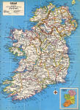


Automatic Summarisation
Summarisation is the process of reducing a piece of information to its core or essence.
Many genres:
  sound bites
  footie highlights
  newspaper headlines
  minutes of a meeting
  biographies
  abridgments
TV Digest
Map of Ireland
Newspaper
Headlines
Magazine Cover

Slide 3
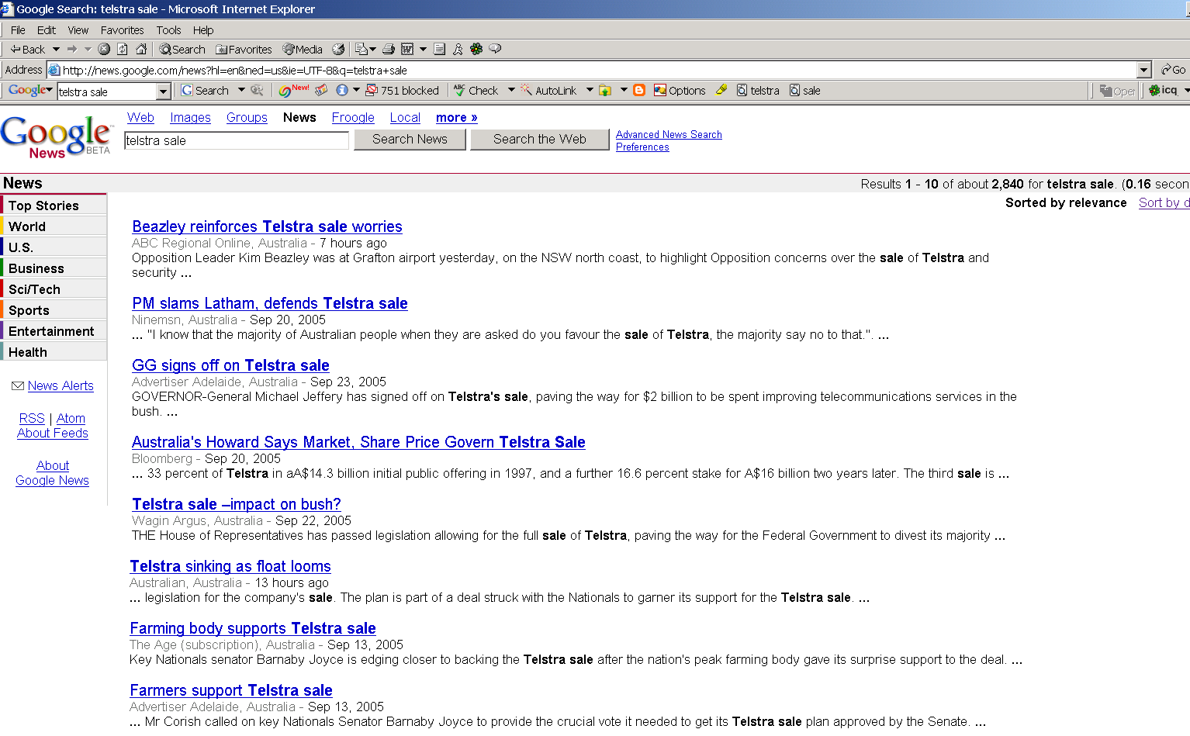

Slide 4
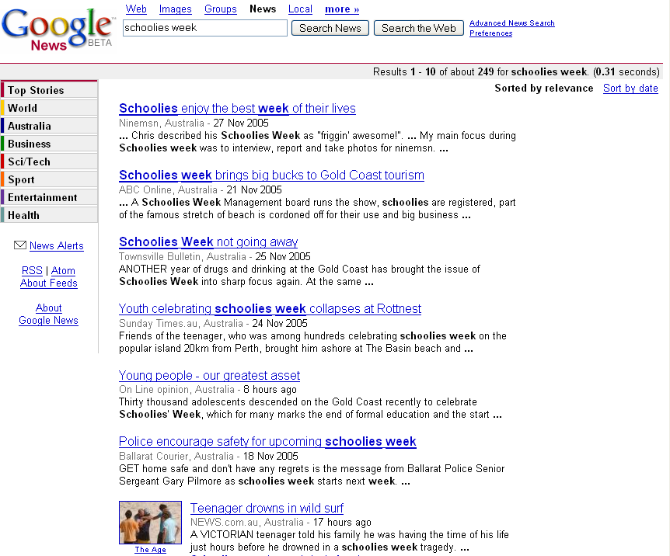

Slide 5
Overview
Introduction
Single Document Summarisation
Multi-Document Summarisation
Summarisation Evaluation
Future Directions in Summarisation

Slide 6



Typical Summarisation System
COMPRESSION RATE: Headline, Gist, Paragraph…
FORM
PURPOSE
FOCUS
EXTRACT
INDICATIVE
GENERIC
ABSTRACT
INFORMATIVE
PERSONALISED
CRITICAL
Single Document
Content
Representation
Conceptual
Organisation
Realisation
OR
Summary
On-topic Document Cluster

Slide 7
Summarisation: a three step process
Content Representation: builds an internal representation of the source text
Conceptual Organisation: decides what concepts/themes/events to include in the summary
Realisation: involves the actual generation of the summary.

Slide 8
Summary Characteristics
Compression Rate (summary length ÷ source document length)
  A title or headline; a gist; a single-document versus a multi-document summary;
Summary Form
  An extract is a summary consisting entirely of material copied from the input
  An abstract is a summary which contains at least some material that was not present in the input
Summary Purpose
  An indicative summary provides a reference function for selecting documents for more in-depth reading
  An informative summary covers all the salient information in the source at some level of detail
  A critical summary evaluates the subject matter of the source, expressing the abstractor's views
Summary Focus
  Query-specific vs. query-independent
  A NL question
  User profile

Slide 9
From Extraction to Abstraction
Research interests/publications/lecturing/supervising
My publications list probably does a reasonable job of ostensively defining my interests and past activities. For those with a preference for more explicit definitions, see below.
I'm now working at the CIIR with an interest in automatically constructed categorisations and means of explaining these constructions to users. I also plan to work some more on a couple aspects of my thesis that look promising.
Supervised by Keith van Rijsbergen in the Glasgow IR group, I finished my Ph.D. in 1997 looking at the issues surrounding the use of Word Sense Disambiguation applied to IR: a number of publications have resulted from this work. While doing my Ph.D., I was fortunate enough to apply for and get a small grant which enabled Ross Purves and I to investigate the use of IR ranked retrieval in the field of avalanche forecasting (snow avalanches that is), this resulted in a paper in JDoc. At Glasgow, I also worked on a number of TREC submissions and also co-wrote the guidelines for creating the very short queries introduced in TREC-6. Finally, I was involved in lecturing work on the AIS Advanced MSc course writing and presenting two short courses on Implementation and NLP applied to IR. I also supervised/co-supervised four MSc students. The work of three of these bright young things have been published in a number of good conferences.
My first introduction to IR was the building (with Iain Campbell) of an interface to a probabilistic IR system
OZJet’s maiden flight was 40 minutes late leaving Melbourne, half an hour late getting into Sydney, there was no champagne and the exit sign fell off the emergency door when it landed.
But the chairman Paul Stoddart said he always expected a few hiccups on the first day of operations for the all-business-class outfit.
30%
Extraction
2%
Abstraction
OZJet airline chairman unfazed by maiden flight hiccups

Slide 10
Extraction versus Abstraction
Method | Characteristics | Strengths | Weaknesses
Extraction | Cut-and-paste approach based around a measure of sentence salience. | Simple; Trainable; Analyses shallow NLP features; Domain independent. | Can only provide low rates of compression; Summaries can be incoherent – revision strategies needed;
Abstraction | Contains new material; Requires auxiliary knowledge sources; May involves NL generation. | Provides degree of generalisation, allowing for very high compression rates; Can use generation to enforce coherence. | Domain specific; Increased likelihood of errors depending on degree of generalisation/paraphrasing applied;

Slide 11
Overview
Introduction
Single Document Summarisation
Multi-Document Summarisation
Summarisation Evaluation
Future Directions in Summarisation

Slide 12

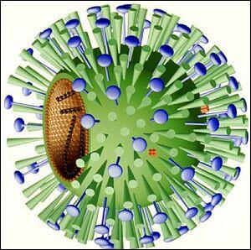
Word Frequencies and Text Meaning
Vitamin pills could increase flu risk
Amsterdam
November 21, 2005 - 3:32PM
Taking supplements like vitamin pills could increase the risk of catching the flu, according to a Dutch team who have been engaged in a three-year project to research susceptibility to the illness.
Scientists have long queried the usefulness of the supplements taken by millions of Europeans in the belief that they increase their wellbeing and help ward off disease.
The Grote Griepmeting (a large flu monitoring) study said stress was a factor that was clearly linked to increased susceptibility to illnesses like the flu.
Men and women suffering from stress were a third more likely to come down with fever and shaking than more relaxed people, the study found.
But there were also indications that taking vitamin pills was linked to higher incidence of illness, although this effect could be influenced by the fact that stressed people might be more likely to take supplements.
"In this year's measurements, we are looking into whether habitual pill takers are not coincidentally those people under the most stress or who have other lifestyle habits that increase the chance of flu," biologist Karin Postelmans said.
Linking stress to catching the flu, Postelmans said that the stress hormones cortisol and adrenaline "disrupt the efficiency of organs that are involved in making and controlling resistance cells".
Adults are also more likely to fall ill, if they have pets or children in the home. Pets led to a 30 per cent rise in the chance of flu and children to a 40 per cent rise, Postelmans said.
Important Words
High Frequency Words
Unimportant Words
Low Frequency Words
flu 7
stress 6
increase 5
take 5
pill 4
ill 4
supplement 3
people 3
vitamin 3
Postelman 3
link 3
pet 2
disease 1
cell 1
control 1
research 1
scientist 1
project 1
fever 1
Influenza 1
measurement 1
look 1
coincidental 1
third 1
large 1
year 1

Slide 13
Extractive Summary
  [1] Taking supplements like vitamin pills could increase the risk of catching the flu according to a Dutch team who have been engaged in a three-year project to research susceptibility to the illness.
  [3] The Grote Griepmeting a large flu monitoring study said stress was a factor that was clearly linked to increased susceptibility to illnesses like the flu.
  [5] But there were also indications that taking vitamin pills was linked to higher incidence of illness although this effect could be influenced by the fact that stressed people might be more likely to take supplements.
30%
Mead Demo @ http://tangra.si.umich.edu/clair/md/demo.cgi

Slide 14
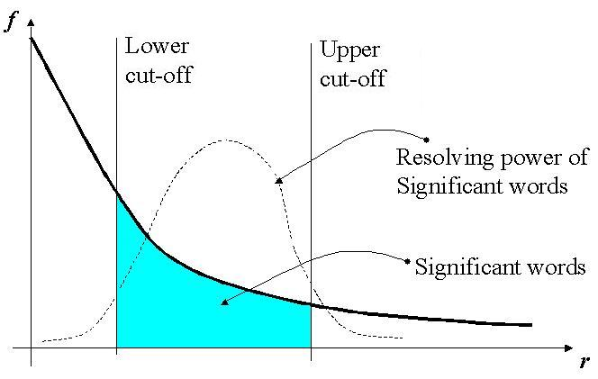
Term Frequency Feature
Luhn (1958) – first suggested that content bearing words could be extracted from text by filtering out stopwords and then identifying frequently occurring terms.

Slide 15
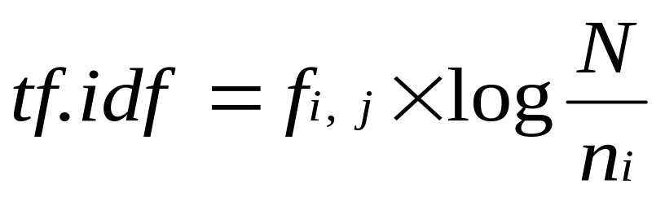
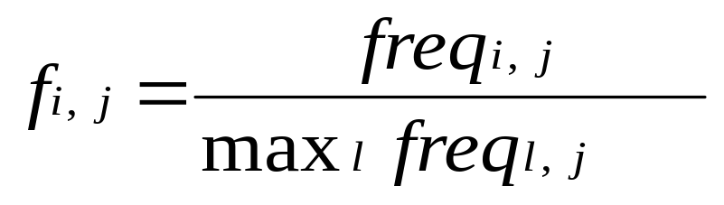
TF.IDF Feature
TF.IDF (Spark-Jones, 1972) term importance is proportional to the frequency of the term in the document and inversely proportional to the total number of documents in the corpus that the term occurs in.
(Baeza-Yates, Ribeiro-Neto, 1999)

Slide 16
Text Features and Summarisation
Some sentence features that can be used to identify salient summary sentences in the source text:
  Location: position of sentence in document, position in paragraph/section, section depth, particular sections (e.g., title, introduction, conclusion)
  TF or TF.IDF: presence of statistically salient terms in sentence
  User Information: presence of user-defined query terms; user profile information
  Cue phrases: presence of phrases that often introduce key ideas (“in summary”, “our investigation shows”, “the purpose of this article is”,..), emphasises (“important”, “in particular”,...)
  Cohesion: presence of terms that are strongly related to other terms through lexical cohesive relationships

Slide 17

Feature-based Sentence Extraction
Summariser
Organisation:
Combine feature
weights into single
score, and rank
sentences.
Representation:
Assign feature values to each sentence.
Realisation:
Extract top n weighted sentences.
F1, F2, F3, … Fn
Edmundson (1969): used a weighted linear combination function.
Kupiec et al. (1998): used a machine learning algorithm => Bayes classifier

Slide 18
A Trainable Document Gister
A gist is a very short summary, ranging in length from a single phrase to a sentence, that captures the essence of a piece of text ~ 75 bytes long.
Decision tree classifier used to predict the ‘summarisation power’ of each word in the source text based on its set of feature-value pairs.
Features included:
  Linguistic Features: Lexical cohesion score; Part-of-speech tags.
  Statistical Features: tf and idf.
  Positional Features: Word Position in text.
WORD: Supplement
Lexical cohesion score: 2.4
Noun: 1
Verb: 0
ADJ: 0
Term Freq: 3
IDF: 0.85
Position: 1.0
Doran et al. News Story Gisting at University College Dublin. In the Proceedings of DUC, 2004.

Slide 19
Positive and Negative Training Examples
Training Data
Source Document
Israel has threatened to close down the Palestinian-run Gaza airport over a security violation, an Israeli official said Tuesday, a move that could further undermine the already fragile peace process. Palestinian airport workers refused to allow Israeli security officials to check the identity of passengers who arrived on an Egyptian plane Sunday
afternoon, most of whom worked for the Palestinian Authority, according
to Civilian Airport Authority Director. Israel retains security control over flights arriving to Gaza International Airport. The airport's opening last month, stipulated by the accords brokered by U.S. President Bill Clinton at Wye River, was hailed by Palestinians as a milestone toward independence and statehood.
Human Summaries
[A] Israel threatens to close Gaza Airport over security; Accord short-lived.
[B] Israeli agents threaten Gaza Airport closure. Security violations charged.
[positive (in red) and negative (in black) examples of summary terms]

Slide 20

Decision Tree Approach
Training Data
Feature
Assignment
C5.0
Learning
Algorithm
Decision Tree Classifier
Summariser
Test Data
Decision Tree
Classification
Feature Assignment
Extraction

Slide 21
Discourse Feature: Lexical Cohesion
Cohesion analysis looks at how words are semantically related – gives a text a feeling of connectivity and flow
Coherence analysis figures out if the text makes sense - a more computationally expensive process
Lexical Chains are clusters of semantically related words. They can be are used to examine the lexical cohesive structure of a text and identify important themes in that text.

Slide 22
Word Frequencies and Text Meaning
Vitamin pills could increase flu risk
Amsterdam
November 21, 2005 - 3:32PM
Taking supplements like vitamin pills could increase the risk of catching the flu, according to a Dutch team who have been engaged in a three-year project to research susceptibility to the illness.
Scientists have long queried the usefulness of the supplements taken by millions of Europeans in the belief that they increase their wellbeing and help ward off disease.
The Grote Griepmeting (a large flu monitoring) study said stress was a factor that was clearly linked to increased susceptibility to illnesses like the flu.
Men and women suffering from stress were a third more likely to come down with fever and shaking than more relaxed people, the study found.
But there were also indications that taking vitamin pills was linked to higher incidence of illness, although this effect could be influenced by the fact that stressed people might be more likely to take supplements.
"In this year's measurements, we are looking into whether habitual pill takers are not coincidentally those people under the most stress or who have other lifestyle habits that increase the chance of flu," biologist Karin Postelmans said.
Linking stress to catching the flu, Postelmans said that the stress hormones cortisol and adrenaline "disrupt the efficiency of organs that are involved in making and controlling resistance cells".
Adults are also more likely to fall ill, if they have pets or children in the home. Pets led to a 30 per cent rise in the chance of flu and children to a 40 per cent rise, Postelmans said.
Important Words
High Frequency Words
Unimportant Words
Low Frequency Words
flu 7
stress 6
increase 5
take 5
ill 4
vitamin_pill 3
supplement 3
people 3
Postelman 3
link 3
pet 2
disease 1
cell 1
control 1
research 1
scientist 1
project 1
fever 1
Influenza 1
measurement 1
look 1
coincidental 1
third 1
large 1
year 1

Slide 23
Lexical Cohesion and Lexical Chains
Halliday and Hasan (1976): Five types of lexical cohesion
Repetition, Synonymy, IS_A, HAS_A, Collocation
Vitamin pills could increase flu risk
Amsterdam
November 21, 2005 - 3:32PM
Taking supplements like vitamin pills could increase the risk of catching the flu, according to a Dutch team who have been engaged in a three-year project to research susceptibility to the illness.
Scientists have long queried the usefulness of the supplements taken by millions of Europeans in the belief that they increase their wellbeing and help ward off disease.
The Grote Griepmeting (a large flu monitoring) study said stress was a factor that was clearly linked to increased susceptibility to illnesses like the flu.
Men and women suffering from stress were a third more likely to come down with fever and shaking than more relaxed people, the study found.
But there were also indications that taking vitamin pills was linked to higher incidence of illness, although this effect could be influenced by the fact that stressed people might be more likely to take supplements.
"In this year's measurements, we are looking into whether habitual pill takers are not coincidentally those people under the most stress or who have other lifestyle habits that increase the chance of flu," biologist Karin Postelmans said.
Linking stress to catching the flu, Postelmans said that the stress hormones cortisol and adrenaline "disrupt the efficiency of organs that are involved in making and controlling resistance cells".
Adults are also more likely to fall ill, if they have pets or children in the home. Pets led to a 30 per cent rise in the chance of flu and children to a 40 per cent rise, Postelmans said.
LEXICAL CHAINS
[supplement, vitamin_pill]
[flu, illness, disease, fever, shaking]
[project, team, research, study]
[stress, stress hormones, cortisol, adrenaline]

Slide 24
WordNet
WordNet is an online thesaurus whose design is inspired by current psycholinguistic theories of human lexical memory.
Words are connected in a vertical fashion via hypernymy (is_a) and hyponomy (kind_of) relationships, and horizontal via meronymy (part_of) and holonymy (has_part) relationships.
Each unique sense of a word is represented by a synset number – represents a synonymous set of words e.g. {car, automobile}
http://wordnet.princeton.edu/

Slide 25
WordNet Taxonomy
group
person
family
relative
hyponymy
brother
sister
meronymy
antonymy

Slide 26
Using WordNet to Find Semantic Links
Supplement
Vitamin_Pill
Publication
Dietary
Pill
Nutriment
Textual Matter
Nutriment
Medicine
SENSE OF WORD
KIND-OF (HYPONYMY)
HAS-PART (HOLONYMY)
PART-OF (MERONYMY)

Slide 27

Lexical Chaining Algorithm
Chain 1
Chain 2
Chain 3
Chain 4
Chain 5

Slide 28
Lexical Chaining Algorithm
Chain 1
Chain 2
Chain 3
Chain 4
Chain 5

Slide 29
Lexical Chaining Algorithm
Chain 1
Chain 2
Chain 3
Chain 4
Chain 5

Slide 30
Lexical Chaining Algorithm
Chain 1
Chain 2
Chain 3
Chain 4
Chain 5

Slide 31
Lexical Chaining Algorithm
Chain 4
Chain 1
Chain 2
Chain 3
Chain 5

Slide 32

Lexical Cohesion Score
Relationship Type rel(i,j) | Score
Repetition | 1
Synonymy | 0.9
Hyponymy/Meronymy | 0.7
Path length > 1 in WordNet | 0.4
Statistical | 0.4
[supplement (3), vitamin_pill (3)]
Path Length = 2
Score(chain) = (3 + 3) * 0.4 = 2.4

Slide 33
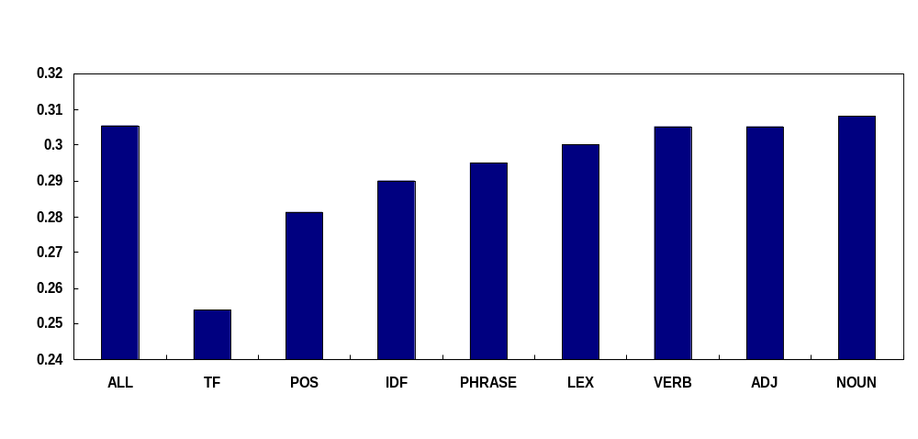
Feature Importance
Figure 1: Effect on the ROUGE (n-gram = 1) score when features are ignored by the classifier when identifying salient gist words.
Doran et al. News Story Gisting at University College Dublin. In the Proceedings of DUC, 2004.

Slide 34
Overview
Introduction
Single Document Summarisation
Multi-Document Summarisation
Summarisation Evaluation
Future Directions in Summarisation

Slide 35
Multi-document Summarisation
Extension of single-document summarisation to collections of related documents
  Naïve approach: concatenate each individual summary. Problem: repetition of information across documents!
Requires fusion of information across documents
  Elimination, aggregation, and generalisation operations carried out on collection instead of individual documents
Collections can vary considerably in size
Different methods for different ranges (e.g, cluster first if > n)
Higher compression rates usually needed, hence abstractive approaches are required

Slide 36
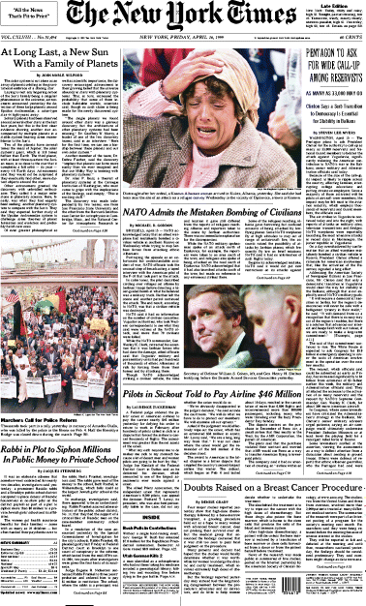
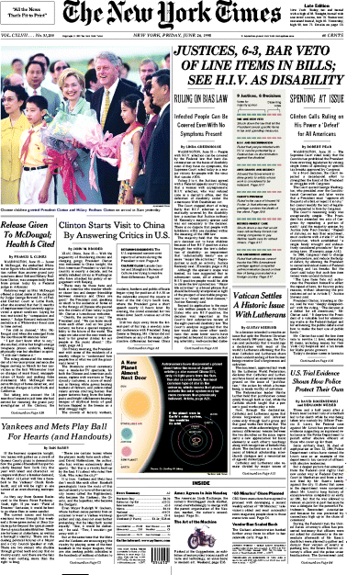
Multi-document Summarisation
YESTERDAY
TODAY: 6AM
TODAY: 10AM
+
+
=
Summary
Irish Independent
NY Times
Irish Times
Identify common topics between news documents by clustering sentences across documents
Rank the “importance” of each cluster
Extract a representative sentence from each of the high ranking clusters until a certain compression rate is reached.
Use sentence ordering strategy such as the document timestamp of extracted sentence
Revise summary: elimination, aggregation, and generalization

Slide 37
Sentence Clustering using the VSM
The simplest and most common sentence clustering technique used in summarisation is based on the Vector Space IR Model (VSM):
  Sentences are represented as vectors of word frequencies
  The similarity between two vectors is calculated using the cosine similarity metric
  If similarity is above a threshold ,T, then add sentence to most similar cluster otherwise create new cluster using sentence
sim ≥ T
sim < T

Slide 38

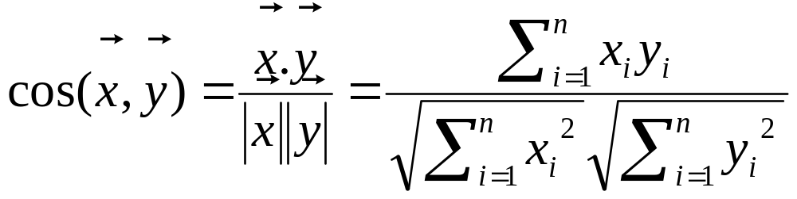
Vectors in n-Dimensional Space
A: “The cat sat on the mat”
B: “My cat was sitting beside the mat”
A
the my cat sit on mat beside
A
2
0
1
1
1
1
0
B
B
1
1
1
1
0
1
1

Slide 39
Sentence Clustering Examples
[PICK A REPRESENTIVE SENTENCE FROM EACH CLUSTER AND ADD TO SUMMARY – HIGHLIGHTED IN RED]
CLUSTER 1: Lab tests reveal Ebola virus outbreak
A Ugandan Ministry of Health statement said laboratory tests had revealed that the Ebola virus was the cause of the epidemic which has been raging in the Gulu district since September.
Laboratory testing carried out at the National Institute of Virology in South Africa indicates that the cause of the outbreak is Ebola virus.
CLUSTER 2: Contagious
The highly contagious disease, which broke out in the district of Gulu, causes its victims to bleed to death.
This is a highly contagious and deadly disease.
CLUSTER 3: Symptoms
Symptoms of the mystery illness include fever, muscle pains and bleeding from the mouth, nose and anus.
The symptoms are high fever, headache, muscular pain, diarrhoea, failure to pass urine and massive haemorrhage with uncontrollable bleeding from all body orifices.

Slide 40
Other Sentence Clustering Approaches
Radev et al. (2000): Centroid-based MDS
  Sentence salience calculated wrt the cosine similarity between sentence and document cluster centroid
Erkan and Radev (2004): LexPageRank
  Based on PageRank algorithm, i.e. the notion of prestige in social networks
  Calculates sentence salience wrt to the number of edges a node (sentence) has and the salience (prestige) of its related sentences

Slide 41
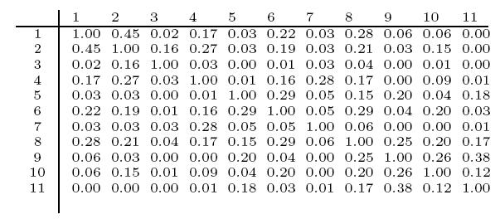
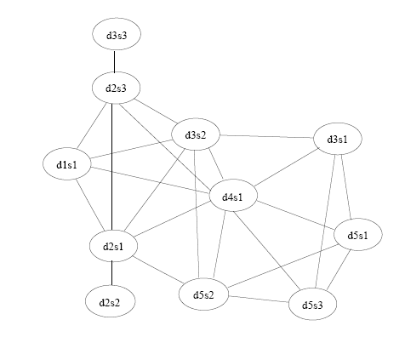
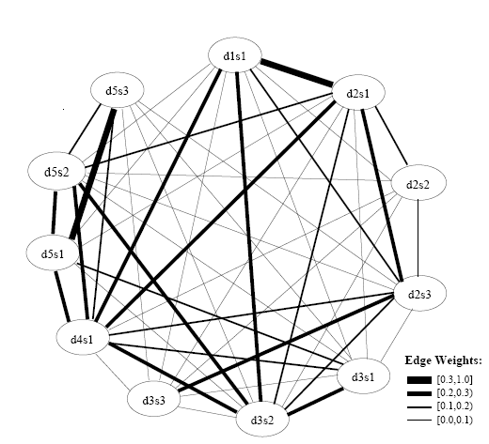
Erkan & Radev. Lexrank: Graph-based centrality as salience in text summarization.
Journal of Artificial Intelligence Research (JAIR), 2004.
Sentence Pair Similarity Matrix
Similarity Graph Corresponding to a threshold of 0.1
Weighted Cosine Similarity Graph

Slide 42
Abstractive MDS and IE
Message Understanding Conferences (1987-1997) ~ 60% accuracy
extract key information w.r.t slots in template
  e.g. terrorist attacks; corporate takeovers; money laundering; etc.
Strengths
  NLG’s need structured info which templates can provide – resulting in more coherent summaries.
  Only include parts of sentences that are relevant - greater compression rates possible
Weakness
  Domain dependent: they can only find information they are told to look for
  Very knowledge intensive to build and hard to maintain when new forms of event occur e.g. new type of terrorist attack

Slide 43
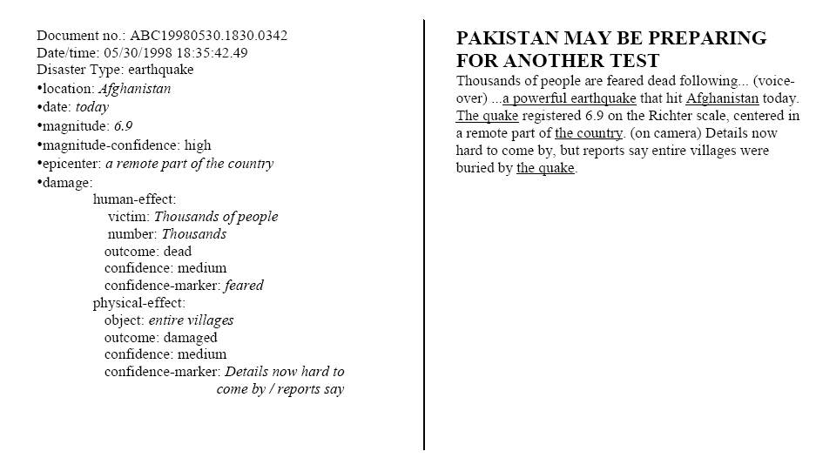
IE for Summarisation
White et al. Multi-document summarization via Information Extraction. HLT 2001. http://www.hlt.utdallas.edu/~vince/papers/hlt01.pdf

Slide 44
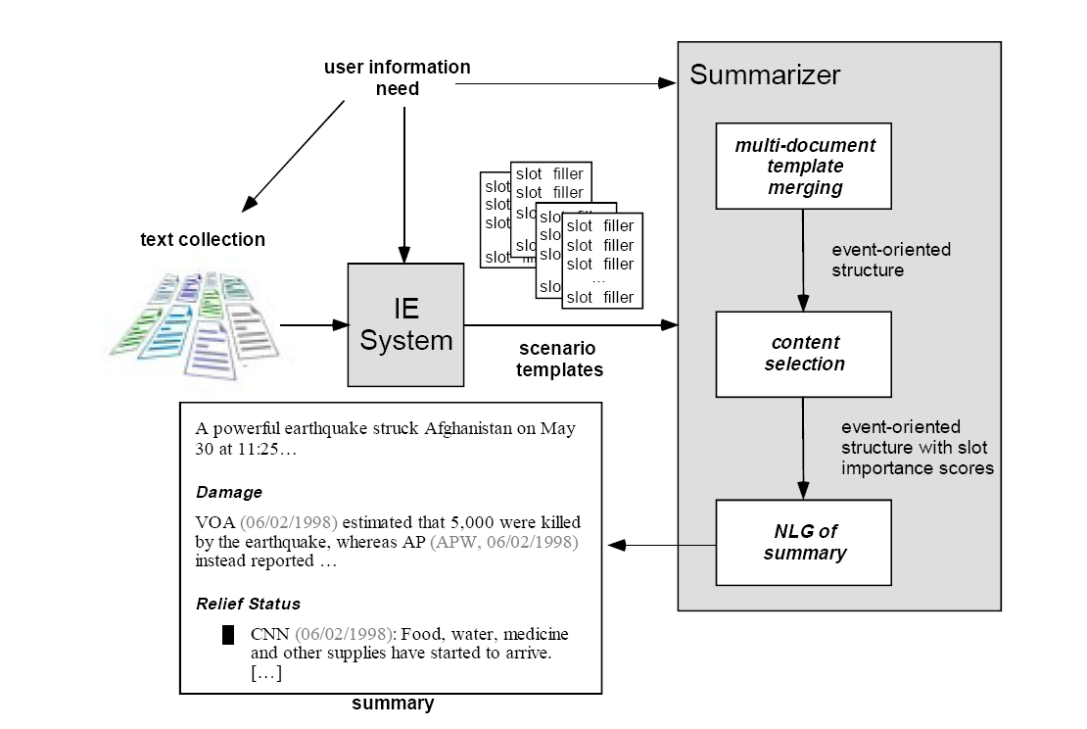
MDS via IE
White et al. Multi-document summarization via Information Extraction. HLT 2001. http://www.hlt.utdallas.edu/~vince/papers/hlt01.pdf

Slide 45
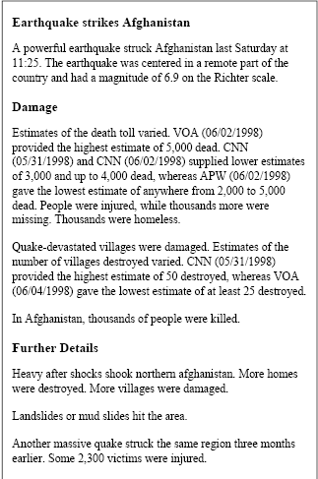
Schema representing layout of summary
Tries to address: Contradiction,
Following up,
White et al. Multi-document summarization via Information Extraction. HLT 2001. http://www.hlt.utdallas.edu/~vince/papers/hlt01.pdf

Slide 46
MDS Components
Multi-document Template Merger
  Heuristics used to group and merge extracted facts across templates and produce a single event-oriented structure
Content Selection
  Assign scores to slots/sentences based on position in document, group/cluster membership, recency of document
Natural Language Generation
  Text planning rules organise text and highlight agreement/disagreement across sources
Related Reading: Radev, McKeown. Generating NL summaries from multiple online sources. Computational Linguistics, 1998.

Slide 47
Columbia University and MDS
SimFinder
Information Fusion
Clustering
Sentence Ordering
Feature Extraction
Sentence Fusion
. . .
Article₁ Article_{n}
Summary
MultiGen System Architecture
- Barzilay, McKeown, Sentence Fusion for Multidocument News Summarization, Computational Linguistics, 2005.
- Hatzivassiloglou et al. 1999. Detecting text similarity over short passages: Exploring linguistic feature combinations via
machine learning. EMNLP’99.

Slide 48
Information Fusion and MDS
1. IDF Spokeswoman did not confirm this, but said the Palestinians fired an anti-tank missile at a bulldozer.
2. The clash erupted when Palestinian militants fired machine-guns and anti-tank missiles at a bulldozer that was building an embankment in the area to better protect Israeli forces.
Fusion Sentence: Palestinians fired an anti-tank missile at a bulldozer.
Example of a cluster of theme sentences

Slide 49
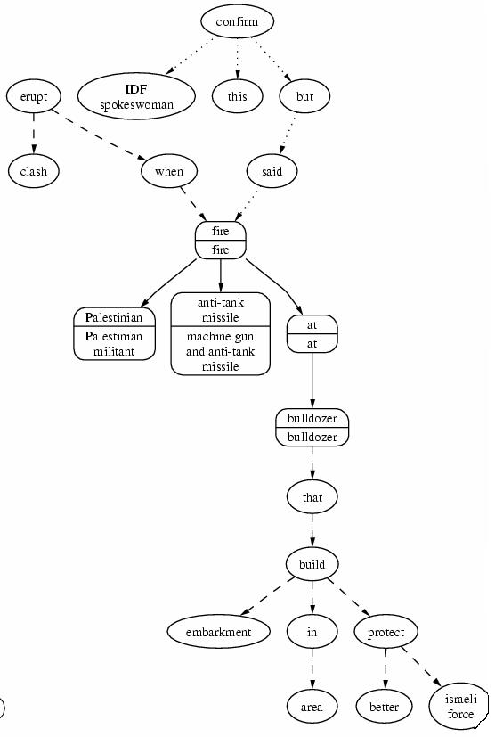
Fusion Lattice: Dependency trees of sentences 1 and 2 have been aligned. Solid lines represent aligned edges. Dotted and dashed edges represented unaligned edges of sentences.

Slide 50

Sentence generation from the fusion lattice
Optimal ordering of vocabulary in fusion sentence determined by generating all possible sentences from the fusion lattice - choose sentence with lowest entropy as the verbalisation of fusion lattice.
Generated Sentence | Entropy
Palestinians fired an anti-tank missile at a bulldozer. | 4.25
Palestinian militants fired machine-guns and anti-tank missiles at a bulldozer. | 5.86
Palestinian militants fired machine-guns and anti-tank missiles at a bulldozer that was building an embankment in the area. | 6.22
Palestinians fired anti-tank missiles at while using a bulldozer. | 7.04
Palestinians fired anti-tank missile at a bulldozer to build a new embankment in the area. | 5.46

Slide 51
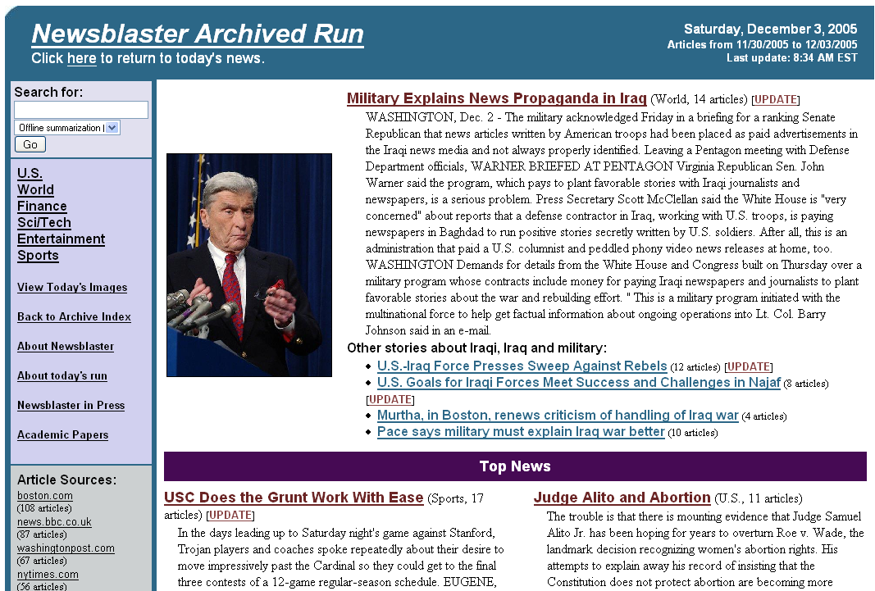
Columbia NewsBlaster System

Slide 52
Overview
Introduction
Single Document Summarisation
Multi-Document Summarisation
Summarisation Evaluation
Future Directions in Summarisation

Slide 53
Summarisation Evaluation
Community Evaluations: SUMMAC’98, NTCIR’00-, DUC’01-
Summary Quality: Coherence and Informativeness
Why is summarisation evaluation interesting?
  How can we address language variability in human generated summaries?
  How can we reduce the cost (time and money) of summary evaluation?
Two types of evaluation:
Intrinsic Evaluation: tests the system itself by directly evaluating summary quality
Extrinsic Evaluation: indirect evaluation – test impact of summarisation on another task

Slide 54
Tipster SUMMAC Evaluation (1998)
First large scale summarisation evaluation inspired by day-to-day activities of US Government Information Analysts.
Two extrinsic tasks
  Ad hoc task: Is text relevant to a given topic?
  Categorisation task: Which category is text relevant to?
  Judges aren’t told if “text” is a summary or a full text
One intrinsic task
  QA-style task: Analyses how well judges can answer topic related questions given a summary => measures informativeness
51 human subjects and 16 summarisation systems took part in evaluation.
Evaluation metrics – Precision, Recall, F1

Slide 55

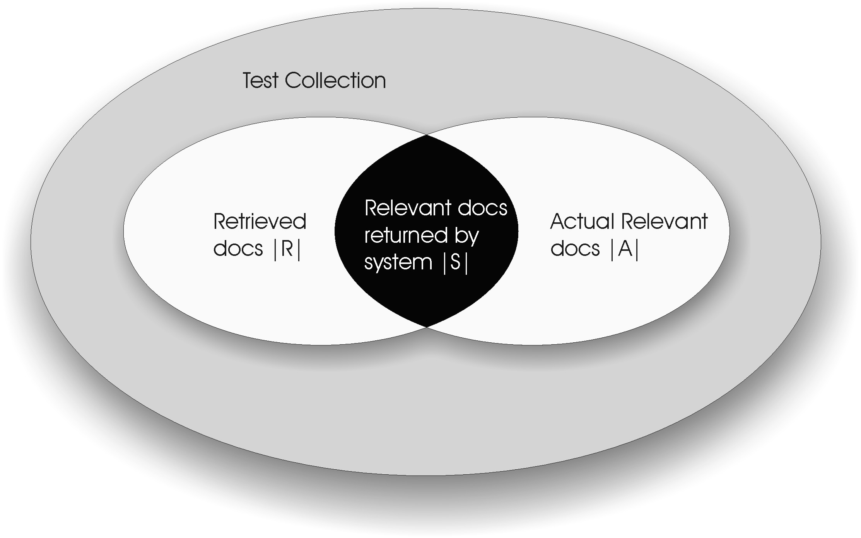

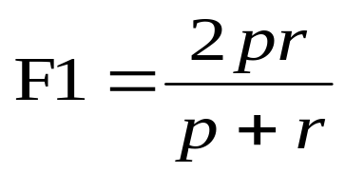
Precision, Recall and F1

Slide 56
SUMMAC Conclusions
Machine generated summaries reduced relevance assessment time (with no statistically significant degradation in accuracy) by:
  40% for generic summaries (categorisation task) and 50% for topic-related summaries (ad hoc task) at low compression rates of 10% and 17% respectively.
Shortcomings of SUMMAC extrinsic evaluations:
  Needed relevance judgements for evaluation which restricted genre to news
  Tasks only required extractive summaries – no abstractive summaries submitted
  Source documents had to be short so that judges could read them in a reasonable amount of time.

Slide 57
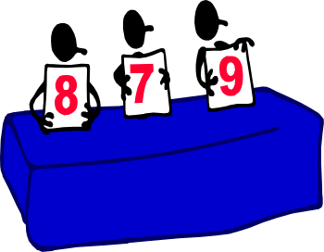
Intrinsic Evaluation Techniques
Ask human judges to rate peer summary quality w.r.t to:
  Fidelity to source document
  A model summary, i.e. human generated summary [Relevance Assessment: DUC Coverage metric]
  Relevance Correlation: Fidelity to a representation of information salience across model summaries [Pyramid method]
  A set of quality questions and no access to source [DUC quality questions – coherence/readability]

Slide 58
Intrinsic Evaluation Techniques
Use automatic evaluation metrics to rate summary quality by calculating:
  Sentence overlap between Human EXTRACTIVE Summary and peer summary [Recall/Precision; Sentence Rank; Relative Utility]
  word/n-gram/semantic unit overlap between peer summary and set of model summaries [Recall/Precision; ROUGE and BE metrics]

Slide 59

DUC Summarisation Workshop
Each year DUC provide participants with summarisation tasks, evaluation datasets and intrinsic summary evaluation methodologies.
  Tasks:
    Single document summarisation;
    Multi-document summarisation (about 10 documents per cluster);
    Topic-focused and question focused summaries;
    Machine Translation output;
    Always fixed length summaries ~ 100 words for MDS;
  Datasets: consist of news stories from various sources
  More info on DUC @ http://www-nlpir.nist.gov/projects/duc/

Slide 60
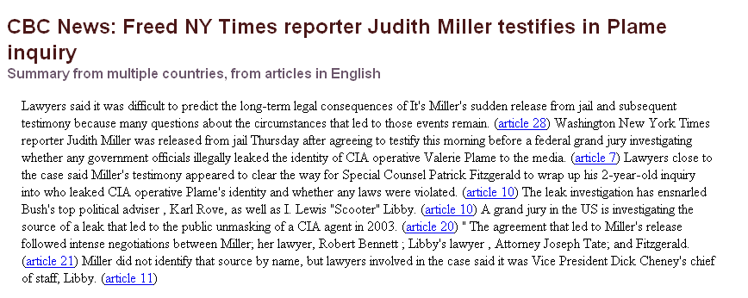
Structure, Coherence; Focus
Referential Clarity
Grammaticality
Incoherent
Non-Redundancy

Slide 61
DUC Manual Evaluation
Summary Quality Questions:
  Grammaticality: The summary should have no datelines, system-internal formatting, capitalization errors or obviously ungrammatical sentences (e.g., fragments, missing components) that make the text difficult to read.
  Non-redundancy: There should be no unnecessary repetition in the summary. Unnecessary repetition might take the form of whole sentences that are repeated, or repeated facts, or the repeated use of a noun or noun phrase (e.g., "Bill Clinton") when a pronoun ("he") would suffice.
  Referential clarity: It should be easy to identify who or what the pronouns and noun phrases in the summary are referring to. If a person or other entity is mentioned, it should be clear what their role in the story is. So, a reference would be unclear if an entity is referenced but its identity or relation to the story remains unclear.
  Focus: The summary should have a focus; sentences should only contain information that is related to the rest of the summary.
  Structure and Coherence: The summary should be well-structured and well-organized. The summary should not just be a heap of related information, but should build from sentence to sentence to a coherent body of information about a topic.
  [Choose: A. Very Good, B. Good, C. Barely Acceptable, D. Poor, E. Very Poor]

Slide 62
Some problems with Manual Evaluations
  Sources of Human Variation:
  Disagreement among coverage scores assigned by judges
  Disagreement exists between the model summaries
  (Harman, Over, 2004) found that despite these sources of variability “system rankings remain comparably consistent when averaged over dozens of document sets, dozens of peer summaries, and 10 or so judges”
  Possible Solutions: Automatic Evaluations; Guided Manual Evaluations; Query-focused Summarisation Task
  Harman, Over, 2004. The effects of human variation in DUC Summarisation Evaluation.
  ACL Summarisation Workshop, 2004

Slide 63
Question Focused Summarisation
Question: What criminal charges can be filed against the driver responsible in fatal alcohol-related car accidents? What factors influence the charges and sentencing? [user profile: granularity="general"]
Summary: The driver who causes a car accident (usually while breaking traffic laws) can be charged with drunk driving if his blood alcohol level meets the state's definition for intoxication (at least 0.08-0.10%). If the accident is fatal, the driver is charge with vehicular manslaughter. This is upgraded to vehicular manslaughter with gross negligence if the driver exhibits a wanton disregard for human life (e.g., has a history of drunk driving).……

Slide 64

DUC Automatic Evaluation 2004
ROUGE evaluation metric: recall oriented metric that calculates the maximum word n-gram overlap between a peer summary and set of model summaries. http://www.isi.edu/~cyl/ROUGE
(Lin and Hovy, 2003) showed that Rouge correlates well with human evaluations of summary quality -
Rouge Paper: http://www.isi.edu/~cyl/papers/WAS2004.pdf

Slide 65
Example
I’ve visited all of the state capitals.
I’ve been to all of the state capitals.
I’ve holidayed in Melbourne, Sydney, Perth, Darwin…

Slide 66
DUC Automatic Evaluation 2005
Basic Elements (BE) Evaluation metric: calculates the average semantic unit (or BE) overlap between a peer summary and set of model summaries.
BE’s identified using syntactic parse tree and a set of “cutting rules”
BE is defined as follows:
  The head of a major syntactic constituent (noun, verb, adjective or adverbial phrase)
  A relation between a head BE and a single dependent
  Two Libyans were indicted for the Lockerbie bombing in 1991
  (Head | Modifier | Relation)
  libyans | two | nn
  indicted | libyans | obj
  bombing | lockerbie | nn
  indicted | bombing | for
  bombing | 1991 | in

Slide 67
Example
I’ve visited all of the state capitals.
I’ve been to all of the state capitals.
I’ve holidayed in Melbourne, Sydney, Perth, Darwin…

Slide 68
Pyramid Manual Evaluation: DUC 2005
Pyramid consists of manually identified Summary Content Units (SCU)
SCU is a text fragment (no greater than an atomic tense clause) that expresses approx. the same meaning across model summaries.
Humans must manual compare pyramid to peer summary
Relevancy scores assigned to SCU’s allow for more fine-grained evaluation

Slide 69
Pyramid Manual Evaluation: DUC 2005
SCU Label: Dogs are used in tracking suspect
W = 4 Contributors in Context
They are excellent at tracking suspects and missing persons, and add muscle to law enforcement personnel in controlling crowds.
Working as a team with police, dogs help hunt down and capture criminal suspects.
Dogs can also pick-up scent from a crime scene and track persons who were at that site
Besides patrolling and narcotics detection, dogs are used in many types of police work, including detection of explosives and flammable liquids, crowd control and manhunts.

Slide 70

Conclusions
ROUGE, BE and the Pyramid Evaluation correlate reasonably well with DUC responsiveness (coverage) measure
Pyramid score inter-annotator agreement acceptable
Advantages/Disadvantages of BE, ROUGE
Advantages/Disadvantages of Pyramid Method
Open research questions
Chicken and Egg!

Slide 71
Overview
Introduction
Single Document Summarisation
Multi-Document Summarisation
Summarisation Evaluation
Future Directions in Summarisation

Slide 72
Recent & Future Directions
Summarisation using language modeling (Banko et al. 2000) (Knight, Marcu, 2000)
Summarisation for different devices: PDA (Butukkokten et al. 2002)
Summarisation of text genres other than news: legal texts (Edinburgh 2003); blogs; emails; chat sessions..
Sentence alignment (MT) for summarisation: (Daume, Marcu, 2005)
Summarisation of diagrams
Web-based summarisation (more robustness!)
Multilingual summarisation (CLEF)
Personalised Summarisation

Slide 73
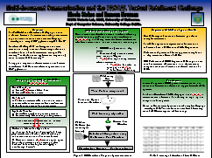
Recent & Future Directions
Component level analysis:
    TREC Novelty Detection task (redundancy removal)
    PASCAL Textual Entailment and logical inference
    Coherence (Barzilay, Lapata, 2005)
Mature system evaluation
    TREC HARD task – presentation strategy is important

Slide 74
Overview
Introduction
Single Document Summarisation
Multi-Document Summarisation
Summarisation Evaluation
Future Directions in Summarisation
Related Links

Slide 75
Related Links
Dragomir Radev: http://www.summarization.com/
Bibliography: http://tangra.si.umich.edu/clair/home/summ-bib.html
MEAD system and Evaluation Framework
Workshop papers: ACL Anthology @ http://www.cs.mu.oz.au/acl/
Books:
  Automatic Summarization: Inderjeet Mani
  Advances in Automatic Text Summarization - edited by Mani and Maybury
Other Summarisation Tutorials:
  Radev: SIGIR 2004 Tutorial
  Marcu, Hovy: ACL’99 www.isi.edu/~marcu/acl-tutorial.ppt
  Maybury, Mani: ACL/EACL’01 www.mitre.org/work/tech_papers/tech_papers_01/mayburymani_tutorial/maybury_mani.pdf

